Slide 1
Rabies Data Science Project (or how to admit a mistake and learn from it)
Working thought - there are places what the CDC specifically recommends getting vaccinated against rabies. Can I link the epidemiological data to any demographic indicator?
Databases:
„Reported number of human rabies deaths” from WHO Global Health Observatory
„Human Development World Index” from Kaggle (dataset is created from Human Development Reports)
Thesis - the lower the HDI the higher the rabies death rate

Slide 2
Loading R essential „tidyverse” packages and „data.table” for fast reading tables
Using skimr package to summary data tables and overview missing values, # duplicates and other information, janitor package to help tidying
Discovering a lot of NA’s in human_rabies_death death count – I decided to continue
Strenuous tidying of hdi database – pivoting longer on almost 1000 columns
Checking if country names and country codes are equivalent using „countrycode” library
Left joining by country and year, filtering out rows with NA
China, India, Philippines - outliers

Slide 3
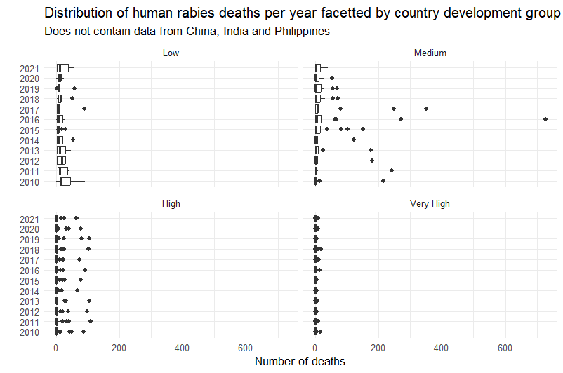
Temptation to manipulate data to suit a thesis
Time to step back!

Slide 4
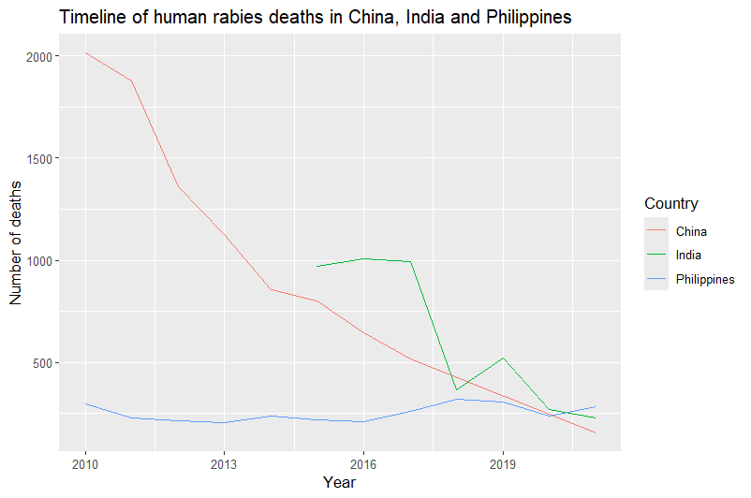
China, India and Philippines deserve their own graphs
Interactive world map graph with 2021 human rabies death data

Slide 5
Conclusions
A lot of missing data from low country development group - presumably because lower developed countries, especially from Afrika, do not report their human rabies deaths
China and India significantly reduce human rabies deaths, Philippines still struggling
Plenty of room for future research – rabies in animals (dogs) vs various indicators?

